Slide 1
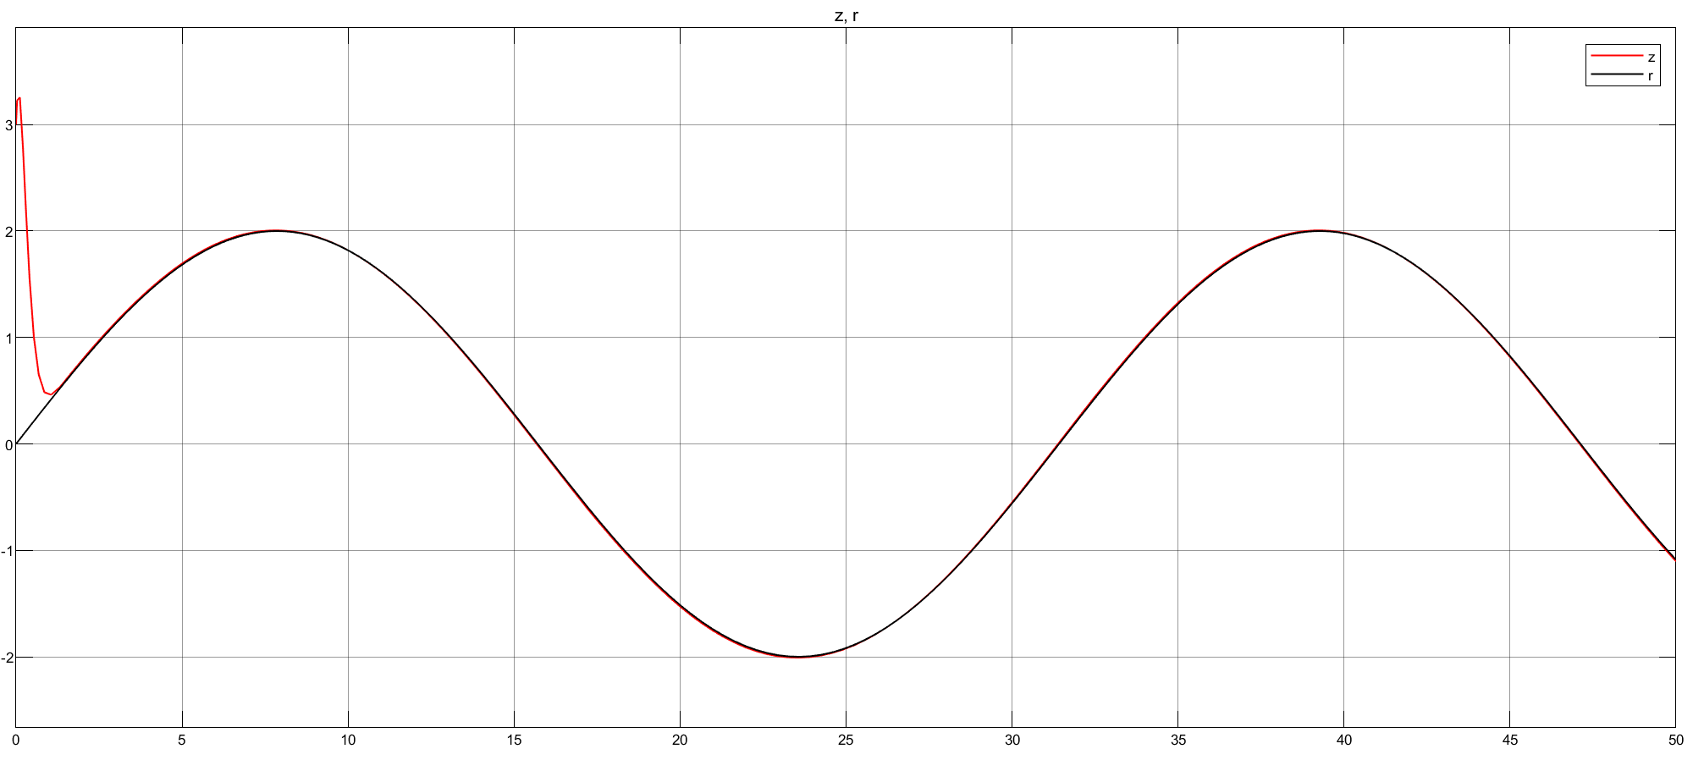
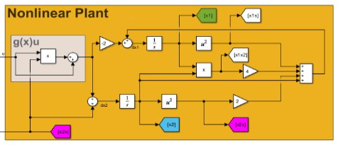
Input State Linearization (ISL)

Slide 2
Outline
Introduction?
MATLAB Symbolic Calculation
Simulink Model
Results and Discussion
Conclusion

Slide 3
I. Introduction
Linearization: is a method of simplifying a nonlinear system into a linear system
Input - state linearization: control technique used to transform a nonlinear system into a linear one by using a change of variables and a suitable control input
Feedback linearization techniques: ways of transforming original system models into equivalent models of a simpler form
The system is controllable, if we can write it using state space form of dx = Ax + Bu after linearization
Input-state linearization: commonly used in robotic control, aerospace systems, and any application, where dealing with nonlinearities directly is challenging.

Slide 4
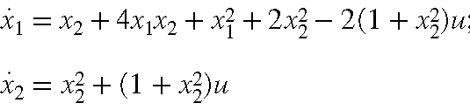
Our nonlinear plant
Steps to linearize
Identify the state transformation:
Find z=h(x) such that the system dynamics in terms of z are linear
Derive the new dynamics:
Calculate dz and substitute the original nonlinear dynamics.
Select the control input transformation:
Choose u=α(x)+β(x)v to achieve a linear form.
Simplify to linear form:
write the dynamics in the form dz=Az+Bv where A&B are matrices, which simplifies the control design.
Nonlinear equation:

Slide 5
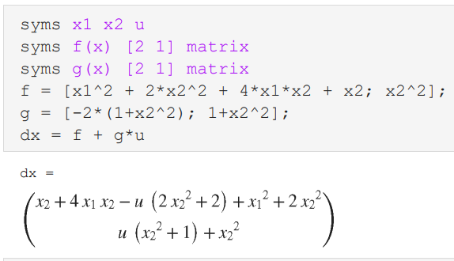
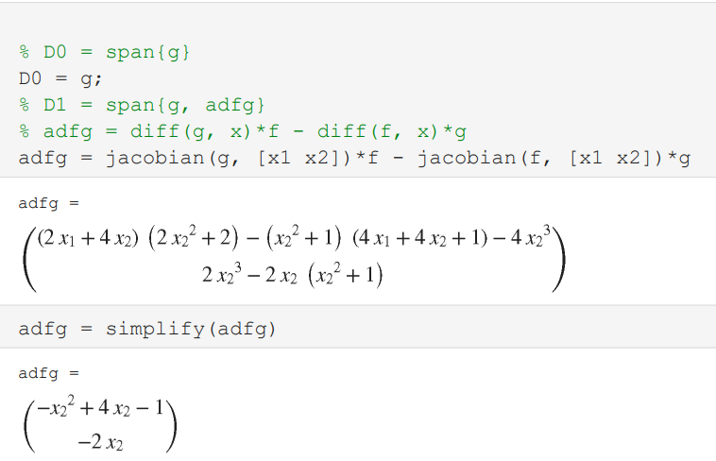
II. MATLAB Symbolic Calculation

Slide 6
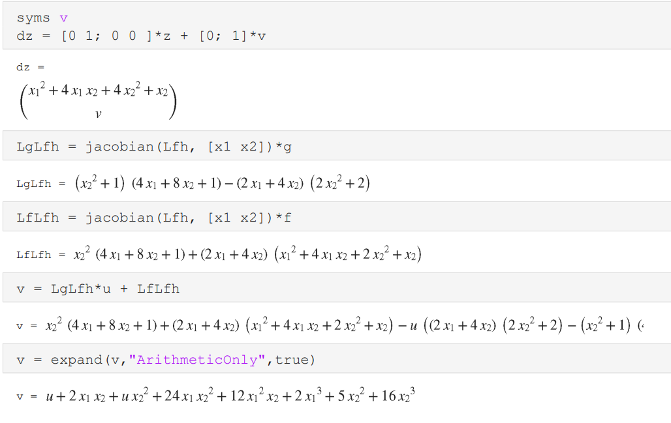
Cont...

Slide 7
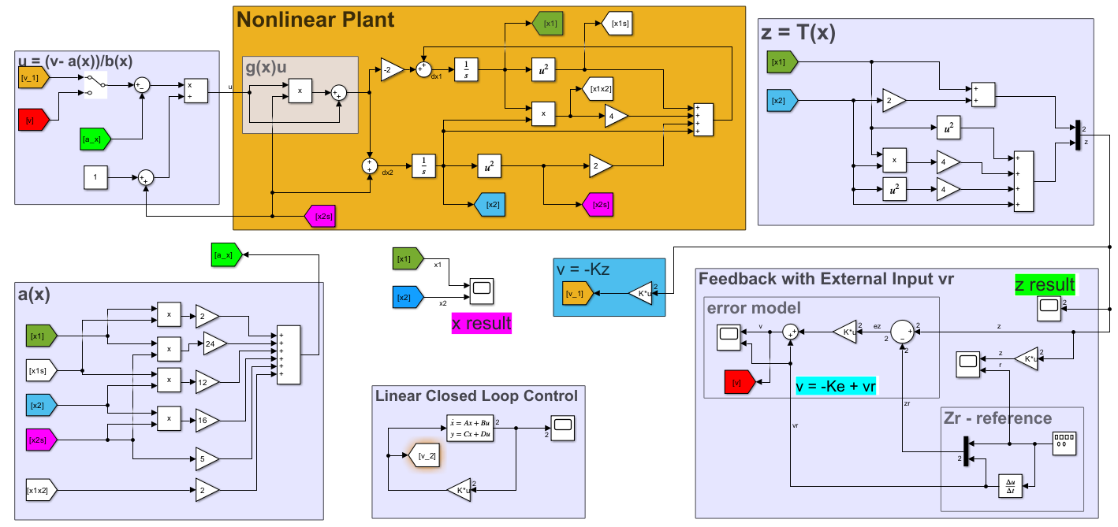
III. Simulink Model

Slide 8
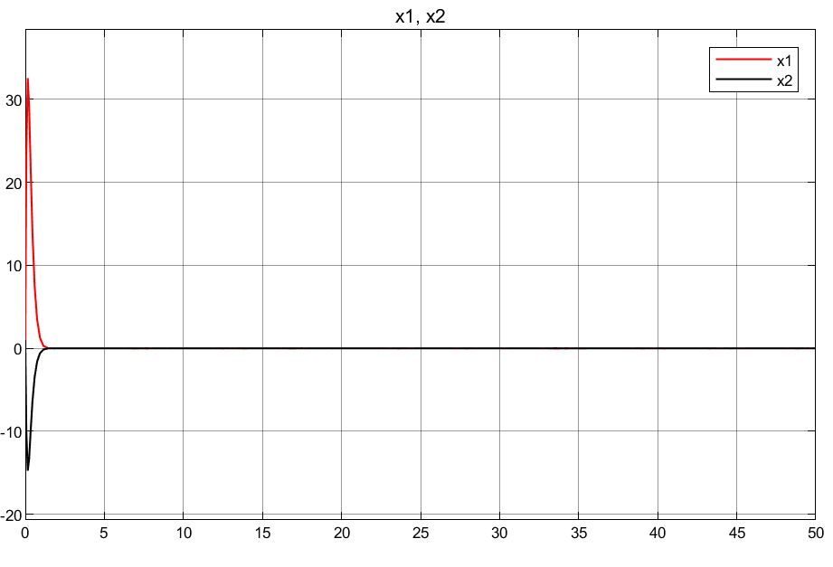
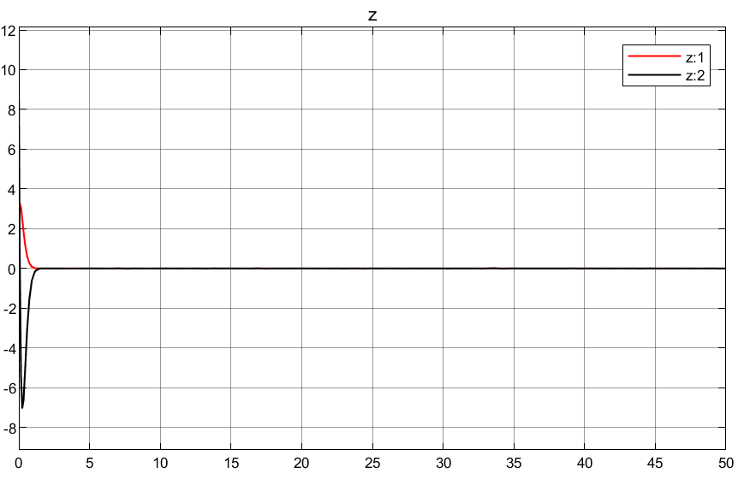
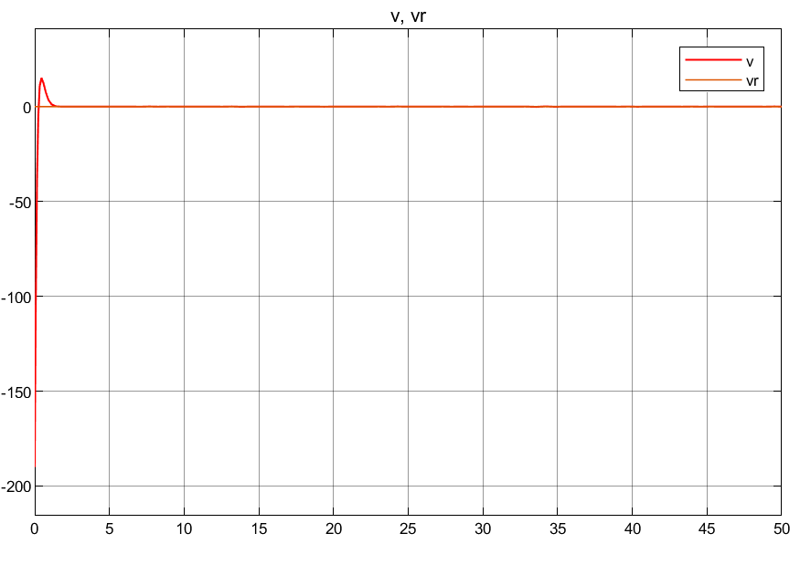
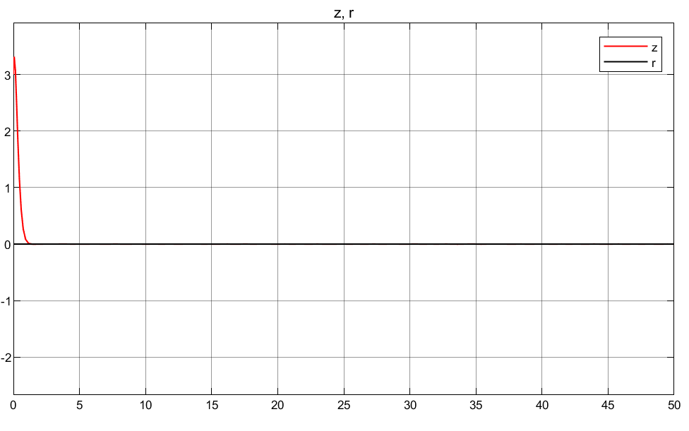
IV. Results at zero reference

Slide 9
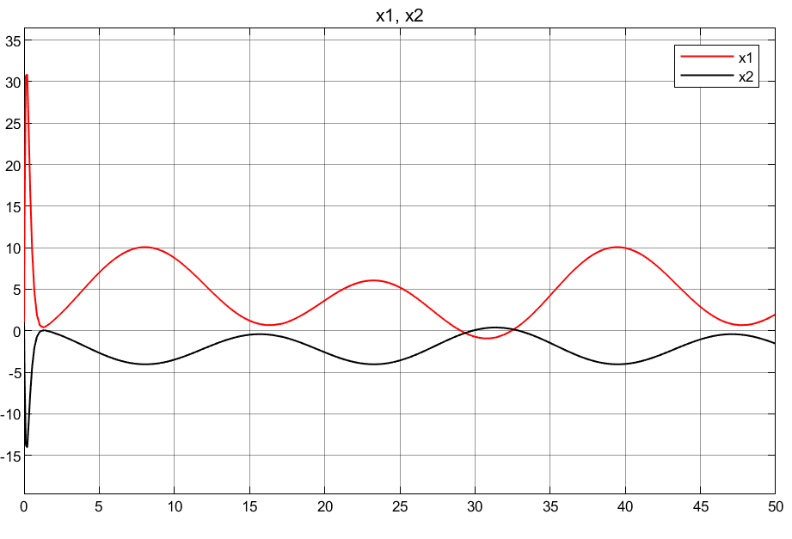
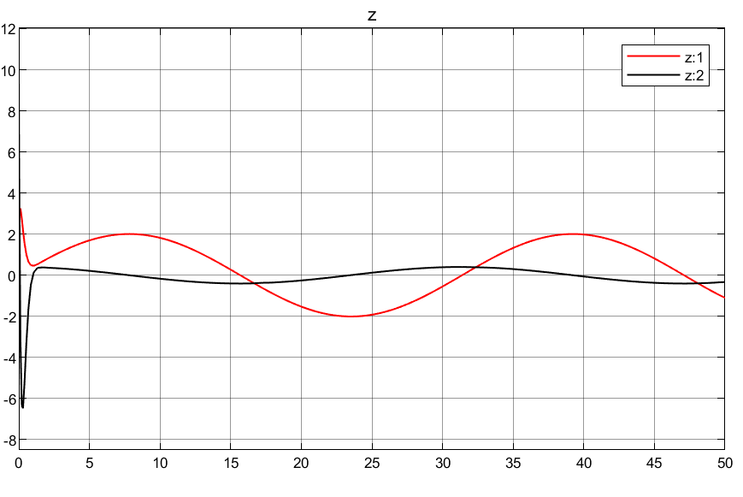
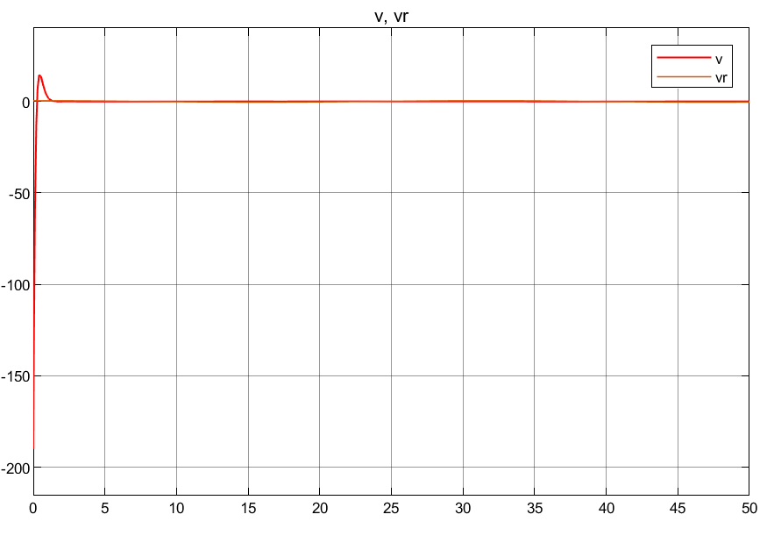
Results of reference tracking(sine wave)

Slide 10
V. Conclusion
We have completed this project and the result we have got showed us the ISL method is a good approach to control nonlinear dynamics plants.
Some of the limitations include:
Complexity to model the plant
Require each states measurement

Slide 11
Thank you! Follow me for more similar posts.
References: lecture materials and mathworks.com tutorials

